Slide 1
Auburn-USDA CS Clinic
Liaison Meeting (4/17/25)

Slide 2
GUI Updates
Final Features!
Scrollbar
Durations
Bug fixes, refactoring, documentation in progress
Working on getting everything packaged into an executable you can just download and run

Slide 3
ML Updates
Model benchmarking data has been fixed
Changed from calculating overall F1 scores by averaging across folds to using raw data from all folds.
Some numbers went down slightly, no major differences though.
Trying another run at using augmented data to train
This is currently in progress
A final go at post processing
Some weird data things
Plan for next week is to get final models trained so they can be packaged with the GUI

Slide 4
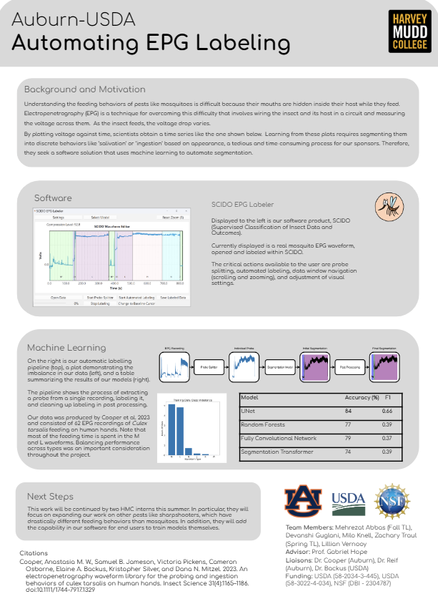
Poster Draft
To be included in this meeting’s minutes

Slide 5
Dr. Backus has the floor!

Slide 6
Questions?

Slide 7
Upcoming Events
Code Freeze 4/25 (Next Friday!)
Final Poster Due 4/29
Draft Report Due 5/2
Final Presentation 5/6
Final Report + Product Due 5/9

